Slide 1
MAC sublayer
Local Area Networks
  Broadcast networks
    Channel allocation
    Ethernet
    Token Networks
Notes:
In this lecture we look at broadcast networks. These networks have a unique set of problems to do with shared transmission media. These problems are dealt with by the Medium Access (MAC) sublayer of the data link layer.
We will review the problems of channel allocation, contention resolution and performance.
We will also look at some examples of broadcast networks such as Ethernet (based on IEEE 802.3) and Token networks.

Slide 2
Channel Allocation
Broadcast Network
  Shared Medium and Bandwidth
  How to allocate it amongst the users
    Static
    Dynamic
  Collision management
Notes:
The major problem to be addressed in any shared access medium is that of channel allocation. We have to decide how the resource is going to be divided up amongst the users. Do we care about fairness? Perhaps we want to be able to sell the resource so that people who want more of it need to pay more.As in all cases of sharing there are trade-offs to be made. The trade-offs can be between the delay in being able to access the network and the bandwidth made available. They can also be between overall performance and protocol or hardware complexity.
The two methods for allocating the resource are static and dynamic.
Static allocation is equivalent to physical addressing where the individual address of a station is given by some physical quantity such as a time slot of a wavelength. The management is very simple and consists of letting the stations know what their physical addresses are. Once this is done the stations communicate independently of each other. The down side is that the amount of bandwidth available to a station does not depend on the overall load, so that when the network is quiet, the station still only has its small portion of the resource and the rest is unused.
Dynamic allocation generally allows each user access to the full resource as if they were the only station but access is not guaranteed and contention with other stations can occur. Under low load conditions, single stations can use the medium very efficiently. However, the contention and inevitable frame collisions mean the maximum possible throughput is less than the total available bandwidth.

Slide 3
Static Channels
User 1
User 2
User 3
..............
User N
How many users?
Simple to manage
Wasteful if slots unused
Little gain over independent provision of physical access
Notes:
The slide shows a static channel allocation of some resource amongst N users. This could be a set of time slots or a set of frequency slots. One issue in designing the network is how many users will there be. Ideally you should have exactly the right number. If there are too few, then the unallocated slots waste bandwidth. Once the maximum number has been achieved there is no possibility for expansion.
Of course the protocol is simple to manage, basically there is nothing to do.
In some cases there is very little gain over the provision of separate physical access.
It is now known that internet traffic is very bursty and is not well described by Poissonian statistics. This means that there is no statistic multiplexing of independent random processes. Static allocation, with its fixed resource provision, is not well suited to this sort of traffic and dynamic schemes are preferred.

Slide 4
Dynamic Allocation
ALOHA
  pure
  slotted
Carrier Sense
  persistent
  non-persistent
Assumptions
  independent arrival times
  (this may be bad)
  Collisions destroy frames
Notes:
Let us now consider some of the dynamic allocation schemes.
In the analysis we will assume that frames arrive independently and are Poisson distributed. All the analysis done is based on this memory less approximation which is now believed to be bad. Unfortunately there is not much else one can say about these systems. We also assume that when a collision between frames occurs that both of them are destroyed and both stations must re-transmit.
The pure ALOHA protocol allows all stations to transmit whenever they are ready. All they have to do is listen to the line to see if their transmission was collision free. If not they wait some random time, in order to prevent synchronisation of collisions, and then try again
Slotted ALOHA is similar except that time is broken up into fixed length slots and stations are only allowed to transmit at the start of a slot.
Carrier sense protocols actually listen to the line before they transmit to see if it is busy. This will clearly avoid some of the collisions that occur in the ALOHA protocol. There can still be collision, sometimes because of propagation delays and sometimes just because of bad luck.

Slide 5
Pure ALOHA Throughput
T
T

Slide 6
Pure ALOHA Throughput
T
T

Slide 7
Pure ALOHA Throughput
T
T

Slide 8
Pure ALOHA Throughput
T
T

Slide 9
Pure ALOHA Throughput
T
T
Each frame will suffer a collision if anyone tries to transmit with a time T either side of the frame starting
Notes:
All the frames in the last few slides are examples of collisions occurring. A given frame is vulnerable to a collision with some part of another frame for a total time equal to twice the frame length.

Slide 10
Slotted ALOHA Throughput
Slot 1
Slot 2
Slot 3
Stations are only allowed to transmit at the beginning of a slot. So the collision probability is reduced compared to pure ALOHA
Notes:
In slotted ALOHA time is broken up into fixed intervals equal to a frame time. In practice the intervals would be slightly longer to allow for a guard band. Each station can only start transmission at the beginning of an interval and so the vulnerable time is reduced compared to pure ALOHA.
One drawback of this technique is that it requires global synchronisation of the transmitters which can be difficult is they are very far apart such as satellites.

Slide 11
ALOHA Throughput
Let G be the mean rate of packet transmission per packet time slot.
The mean system throughput S is
S = G P(zero packets transmitted in the vulnerable time)
for pure ALOHA the vulnerable time is two slots so the mean number of packets sent in the vulnerable time is 2G
From Poisson statistics, P = e^{-2G} so
S_{pure} = G e^{-2G}
for slotted ALOHA the vulnerable time is one slot and again from Poisson statistics P = e^{-G} so
S_{slotted} = G e^{-G}
Notes:
Here we calculate the expected system throughput for the two type of ALOHA protocol. In both cases the system throughput, defined as the fraction of time the system is actually carrying any traffic, is equal to the product of the mean packet rate per packet time and the probability that no collision occurs with that packet. The probability of no collision is equal to the probability that no packets are transmitted during the vulnerable time. It is this probability that is different for the slotted and pure ALOHA protocols.
Recall that for Poisson statistics the probability of k events in an interval with mean n is
P(k,n) = n^{k} e^{-n}/k!
so P(0,n) = e^{-n}
For pure ALOHA we want P(0,2G)
and for slotted ALOHA we want P(0,G)
Using these values we arrive at the results given in the slide.

Slide 12
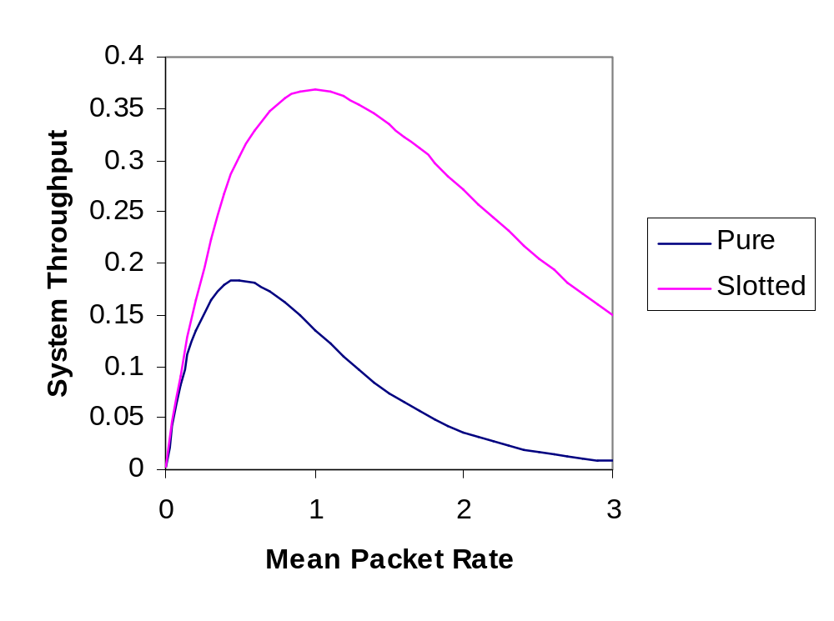
ALOHA Throughput Graph
(Offered)
Notes:
In this graph we plot the system throughput for the two ALOHA protocols. The throughput for slotted ALOHA is indeed higher than for pure ALOHA as we expected from the lower likelihood of collisions.
Note that when the system is quiet, the throughput increases linearly for both protocols and is equal up to a throughput of about 0.1.
Both protocols have a peak throughput above which the system degrades as more and more traffic is offered.
The peak throughput of the pure protocol occurs at G=0.5.
The peak throughput of the slotted protocol occurs at G=1.
Note that both protocols have relatively low system throughput. The slotted system achieving a peak of 36.8% so nearly two thirds of the available system bandwidth is unused.
This low utilisation is due to the random way that each station attempts to transmit. The way to achieve much higher utilisation is by having the stations detect the presence of traffic on the medium and waiting for a quiet time. These protocols are known as Carrier Sense protocols.

Slide 13
Carrier Sense Protocols
Improve throughput by avoiding collisions
  Sense existing traffic
  Include randomness to avoid repeated collision
Persistent vs non-persistent
  persistent protocols continuously sense the channel
  non-persistent protocols wait a random time before re-checking
Collision Detection
  avoids sending the rest of a frame once collision has occurred
Notes:
The carrier sense protocols try to avoid the simplest forms of collision where the medium is already occupied. They sense the channel to see if it is carrying traffic and only transmit during a quiet period. This does not remove all collisions as two stations could be waiting for the end of the same frame to transmit. In order to avoid them continually conflicting a random element is introduced into the protocol.
Protocols can be divided into two categories: persistent and non-persistent. The persistent protocols continuously sense the channel until it becomes free. At this point it then sends a frame (with probability 1 in a continuous time system and with probability p in a slotted system), if a collision occurs it waits a random amount of time before starting again.
The non-persistent protocols have random time intervals between sensing the channel.
These variations differ in the ‘greediness’ of the protocol in grabbing the channel. The idea is that by being less greedy, the overall channel usage goes up and the individual channels wait slightly longer to access the medium.
One other improvement that can be made is to make the transmitters stop transmitting when a collision has been detected.

Slide 14
Collision-Free Protocols
Include negotiation before transmission
  polite protocols
  transmission slots are reserved in advance
  still a system overhead
Hierarchical protocols
  all stations are not equal
Booking period
Transmission
Notes:
Collision free protocols actively manage the channel to ensure that no collisions occur. This can be done by arranging for frame slots to be reserved in advance during a ‘booking period’. Each transmission phase can be of variable length since different numbers of stations may transmit each time.
This protocol sets an upper limit on the bandwidth a single station can access which is lower than the channel bandwidth (unlike ALOHA) since even if only one station wants to transmit, it still needs to go through the negotiation procedure for each frame.
The overhead of the negotiation can be quite small. For N stations transmitting M bit frames it might be N bits for the booking period and N*M bits for the transmission period giving an overhead at peak times of
N/(N+N*M) = 1/(M+1)
Hierarchical protocols have some built in definition of the order of importance of the stations and allow them to transmit preferentially in that order. Although the reservation protocols are not very hierarchical there is still a small advantage to being last to reserve. This is due to the fact that if a low numbered station misses its reservation slot it has to wait for the remainder of this booking period and the entire length of the next one before being allowed to transmit.

Slide 15
Ethernet
IEEE standard 802.3
  1-persistent CSMA
  Collision Detection
  1-10MBit/s
  Ethernet is a minor variation on 802.3
  Media
    Coax, twisted pairs, fibres
    Manchester coding
Notes:
The IEEE standard 802.3 defines a family of 1-persistent (i.e. Always transmit when free) CSMA protocols with collision detection (stop sending a frame once a collision has occurred.
The standard describes a number of media types with transmission speeds ranging from 1 to 10 MBit/s. The commonest found in the Ethernet product (a minor variation in the definition of the frame header) is thin coax or twisted pair and usually runs at 10MBit/s.
The line coding used is usually some form of Manchester coding where essentially two physical bits are used to represent one logical bit. Of course this requires twice the bandwidth as normal binary encoding but allows the system to run without some form of global clock.

Slide 16
802.3 Frame
Bytes 7
1
2 or 6
2 or 6
2
Preamble
Begin frame
Destination address
Source address
Data length
Data
0-1500
0-46
4
Data
Pad
Checksum
Notes:
The 802.3 frame contains the following fields:
Preamble: 7 bytes containing 10101010 which constitutes a 10MHz clock to allow the receiver to synchronise to the transmitter.
Start of Frame: 1 byte containing 10101011, the first pair of ones denotes the start of the frame.
Destination and source addresses: Generally only the 6 byte version is used now. The highest order bit is used to indicate sending to a group address to implement multicasting. An address consisting of all 1’s means ‘everyone’ to implement broadcasting. The second highest bit indicates if the address is local or global. Local adressing allows you to allocate your own addresses. If you want a unique address you have to apply to the IEEE for a global address. There are 46 bits available giving an address space of 7*10¹³.
Length: specifies the length of the data field
Data: the important stuff
Pad: The 802.3 standard defines a minimum frame length for a valid frame as 64 bytes. This field is used to pad out any actual data to the minimum length. The minimum length is included so that small pieces of frame caused by collision can be identified and ignored.
Checksum: A 4 byte CRC checksum computed from the rest of the frame as discussed in lecture 4.

Slide 17
Propagation Effects
Propagation speed
  limited to c, smaller in general = v
LAN size
  allowed size, L, specifies maximum time separation, T
Packet length (bit rate =B)
  must be larger than 2T
N=2LB/v
collision
T
2T
Time
Notes:
So far we have not discussed propagation effects. To put it another way we have been implicitly assuming that the propagation time on the LAN is much shorter than the frame time.
Physically we know that signals are limited in speed to the speed of light but will be smaller than that in any medium. For example in optical fibre the refractive index is about 1.5 meaning that signals travel at about two thirds the speed of light.
As the LAN length increases we have to worry about the propagation time as this will affect the ability to detect a collision. The diagram shows a packet travelling between two stations separated by the maximum allowed length, L, on the LAN corresponding to a propagation time L/v. If a collision occurs, then it will take at least 2T/v before the transmitter hears the collision. If the transmitter had finished sending before then, it would have (incorrectly) concluded that a successful transmission had taken place. The standard therefore restricts the minimum packet length to twice the maximum propagation delay on the LAN. This gives the following relation between the LAN length, the minimum packet length (in bits) and the bandwidth
N=2LB/v
Note the minimum packet length increases with the bandwidth, this will become more and more restrictive as bandwidth requirements increase.

Slide 18
Randomisation
Need randomness to avoid collision locking
Following successful frames there is a collision
  divide time up into contention slots
  apply some algorithm until no contention occurs
X
Successful frame(s)
Contention slots
Notes:
If no randomness were introduced into the protocol there is the possibility that two stations will try to send at the same time and will then continue colliding in step for ever.
In order to avoid this we divide the time up after a collision (marked X) into contention slots whose length is set to the maximum allowed round trip delay on the LAN. Each of the stations involved in the collision then applies some algorithm until the contention is resolved.
One such algorithm is the binary exponential backoff algorithm. Following the collision each station waits 0 or 1 slot before retrying. If there is a further collision the number of slots to chose from is doubled to four and the stations try at random again. Each further collision results in a doubling of the number of slots until 10 collisions have occurred and the number of slots remains at 1024. After 16 collisions, the network is assumed to be broken.
It is important that an implementation does not try to cheat, beware of arguments based on ‘why chose the last slot’.

Slide 19
Token Networks
Originally designed for railways to avoid crashes
  access to a single line section governed by possession of a token
In LANs the token is virtual
  Token ring (IEEE 802.5), passed in one direction
  Token bus (IEEE 802.4), passed around a logical ring
MAC protocols are much more complex than for Ethernet
Notes:
The original concept for token based networks was developed in railways in the last century. The problem was the existence of single line sections of the track where trains would have to travel in both directions. After several bad accidents the token system was introduced whereby a physical token was associated with a particular piece of track. Access to that section was only permitted if the driver was in possession of the token.
Token networks work in much the same way with the virtual token giving the station that has it the permission to send frames onto the network. The MAC sublayer protocolhas to deal with the issue of how long the token can be held for, what order the token is passed around the stations, what the format of the token should be as well as the usual definitions of frame format etc. Since the token has to be passed from station to station it also needs to address the issue of what happens if a station is down.
In general the MAC protocols for the bus (802.4) and the ring(802.5) are much more complicated then for the Ethernet.

Slide 20
Next Lecture
Connecting multiple LANs
  Repeaters
  Bridges
Notes:
In the next lecture we consider the problem of extending networks.
We will discuss the use of repeaters to extend physical length and of bridges to connect LANs with different protocols such as connecting Ethernet to a Token network.

